Slide 1

18CSC202J - OBJECT ORIENTED DESIGN AND PROGRAMMING
Session 1
Topic : PROCEDURAL AND OBJECT ORIENTED PROGRAMMING

Slide 2
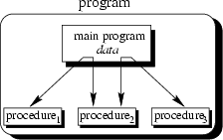
The main program coordinates calls to procedures and hands over appropriate data as parameters.

Slide 3
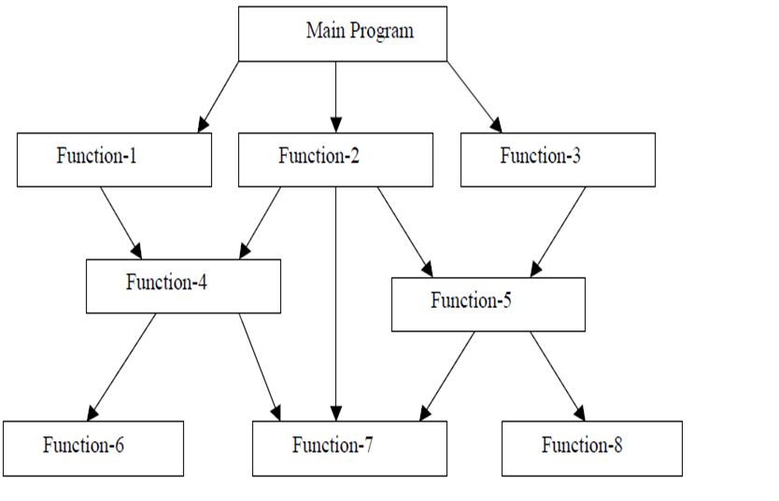
Procedure Oriented Programming Language

Slide 4
C function aspects | Syntax
Function declaration | Return-type function-name(argument list); Eg : int add(int a, int b);
Function definition | Return-type function-name(argument list) { body of function;) Eg : int add(int a, int b) {int c; c=a+b; Return c; }
Function call | Function-name(argument list); Eg : add(5,10);

Slide 5
Features of Procedure Oriented Programming Language
Smaller programs - A program in a procedural language is a list of instructions.
Larger programs are divided in to smaller programs known as functions.
Each function has a clearly defined purpose and a
clearly defined interface to the other functions in the program.
Data is Global and shared by almost all the functions.
Employs Top Down approach in Program Design.

Slide 6
Examples of Procedure Oriented Programming Language
COBOL
FORTRAN
C

Slide 7
Sample COBOL Program(Procedure Oriented)
IDENTIFICATION DIVISION.
PROGRAM-ID.
ENVIRONMENT DIVISION. * procedure will be followed by using few Division
DATA DIVISION.
WORKING-STORAGE SECTION.
77 A PIC 9999.
77 B PIC 9999.
77 ANS PIC 999V99.
PROCEDURE DIVISION.
MAIN-PARA.
DISPLAY \”--------------------------------\”.
DISPLAY \” ENTER A\”
ACCEPT A. * command line argument
DISPLAY \”ENTER B\”.
ACCEPT B.
DISPLAY \”----------------------------------\”.
ADD-PARA.
ADD A B GIVING ANS.
DISPLAY \”-------------------------------------\”.
DISP-PARA.
DISPLAY \”A IS \” A.
DISPLAY \”B IS \” B.
DISPLAY \”ADDITION -\” ANS.
STOP RUN. * to stop the program

Slide 8
Disadvantages of Procedural Programming Language
Unrestricted access
functions have unrestricted access to global data.
Real-world modeling
unrelated (separated) functions and data, the basis of the procedural paradigm, provide a poor model of the real world.
Complex real-world objects have both attributes (data) and behavior (function).

Slide 9
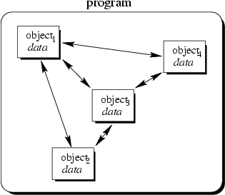
Object-Oriented Concept
Objects of the program interact by sending messages to each other, hence it increases the data security (data can be accessed only through its instances)

Slide 10
Object Oriented Programming
Object-oriented programming is a programming paradigm that uses abstraction in the form of classes and objects to create models based on the real world environment.
An object-oriented application uses a collection of objects, which communicate by passing messages to request services.
The aim of object-oriented programming is to try to increase the flexibility and maintainability of programs. Because programs created using an OO language are modular, they can be easier to develop, and simpler to understand after development

Slide 11
Object-Oriented Concepts
Everything is an object and each object has its own memory
Computation is performed by objects communicating with each other
Every object is an instance of a class. A class simply represents a grouping of similar objects, such as Integers or lists.
The class is the repository for behavior associated with an object. That is, that all objects that are instances of the same class can perform the same actions.
Classes are organized into a singly rooted tree structure, called the inheritance hierarchy. Memory and behavior associated with instances of a class are automatically available to any class associated with a descendant in this tree structure.

Slide 12
Object-Oriented Programming vs. Procedural Programming
Programs are made up of modules, which are parts of a program that can be coded and tested separately, and then assembled to form a complete program.
In procedural languages (i.e. C) these modules are procedures, where a procedure is a sequence of statements.
The design method used in procedural programming is called Top Down Design. This is where you start with a problem (procedure) and then systematically break the problem down into sub problems (sub procedures).

Slide 13
Object-Oriented Programming vs. Procedural Programming
The difficulties with Procedural Programming, is that software maintenance can be difficult and time consuming.
When changes are made to the main procedure (top), those changes can cascade to the sub procedures of main, and the sub-sub procedures and so on, where the change may impact all procedures in the pyramid.
Object oriented programming is meant to address the difficulties with procedural programming.

Slide 14
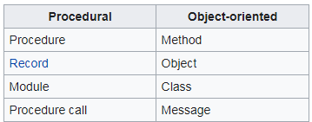
The main difference

Slide 15
Comparison
Procedural Oriented Object Oriented
Program is divided into small parts called ‘Functions’
Program is divided into small parts called ‘Objects’
Global and Local data
Has access specifiers : Public, Private, Protected
Doesn’t have any proper way for hiding data
Provides data hiding and security
Eg: C, VB, FORTAN Eg: C++, JAVA, VB.NET

Slide 16
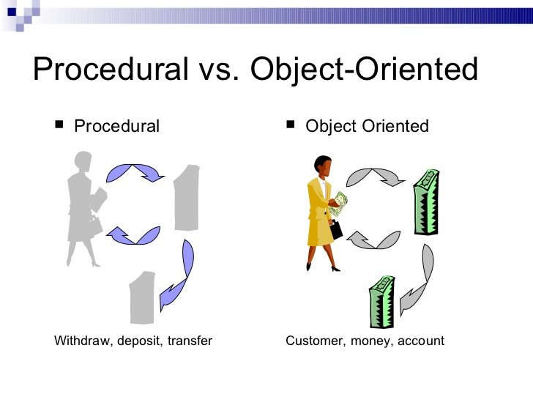
Comparison

Slide 17
Session-2

Slide 18
Topics covered
I/O Operation
Data types
Variable
Static
Constant
Pointer
Type conversion

Slide 19
I/O Operation
C++ I/O operation occurs in streams, which involve transfer of information into byte
It’s a sequences of bytes
Stream involved in two ways
It is the source as well as the destination of data
C++ programs input data and output data from a stream.
Streams are related with a physical device such as the monitor or with a file stored on the secondary memory.
In a text stream, the sequence of characters is divided into lines, with each line being terminated.
With a new-line character (\n) . On the other hand, a binary stream contains data values using their memory representation.

Slide 20
Stream in C
Text Stream
Binary Stream

Slide 21
Cascading of Input or Output Operators
<< operator –It can use multiple times in the same line.
Its called Cascading
Cout ,Cin can cascaded
For example
cout<<“\n Enter the Marks”;
cin>> ComputerNetworks>>OODP;

Slide 22
Reading and Writing Characters and Strings
char marks;
cin.get(marks);//The value for marks is read
OR
marks=cin.get();//A character is read and assigned to marks
string name;
Cin>>name;
string empname;
cin.getline(empname,20);
Cout<<“\n Welcome ,”<<empname;

Slide 23
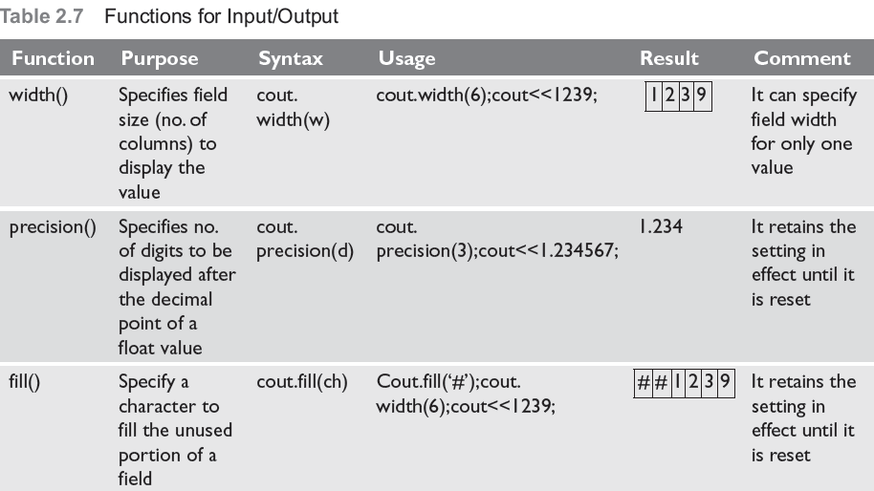
Formatted Input and Output Operations
Formatted I/O
I/O class function and flages
Manipulators
#include<iostream.h>
#define PI 3.14159
main()
{
cout.precision(3);
cout.width(10);
cout.fill(‘*’);
cout<<PI;
Output
*****3.142

Slide 24
Formatting with flags
The setf() is a member function of the ios class that is used to set flags for formatting output.
syntax -cout.setf(flag, bit-field)
Here, flag defined in the ios class specifies how the output should be formatted
bit-field is a constant (defined in ios ) that identifies the group to which the formatting flag belongs to.
There are two types of setf()—one that takes both flag and bit-fields and the other that takes only the flag .

Slide 25
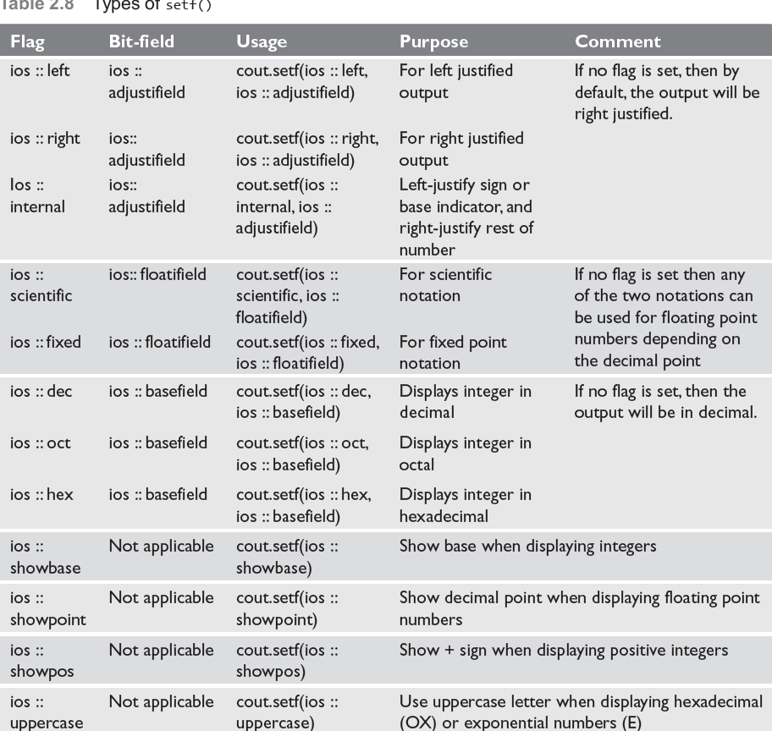

Slide 26
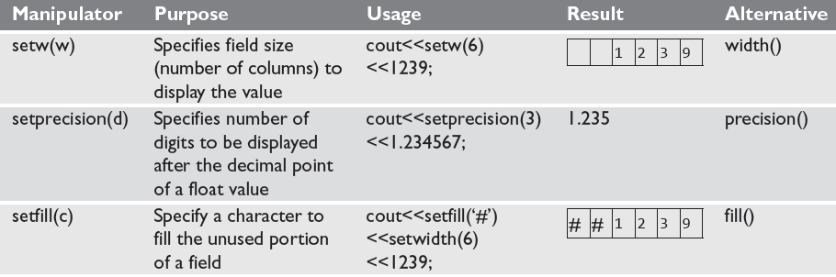
Formatting Output Using Manipulators
C++ has a header file iomanip.h that contains certain manipulators to format the output

Slide 27
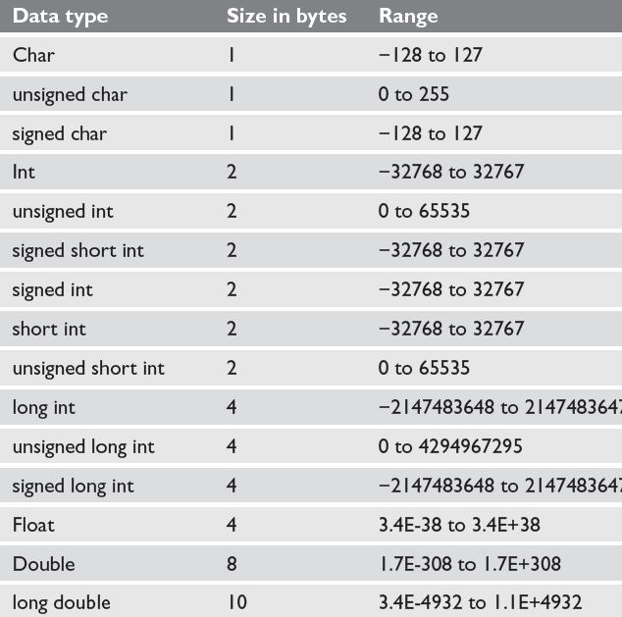
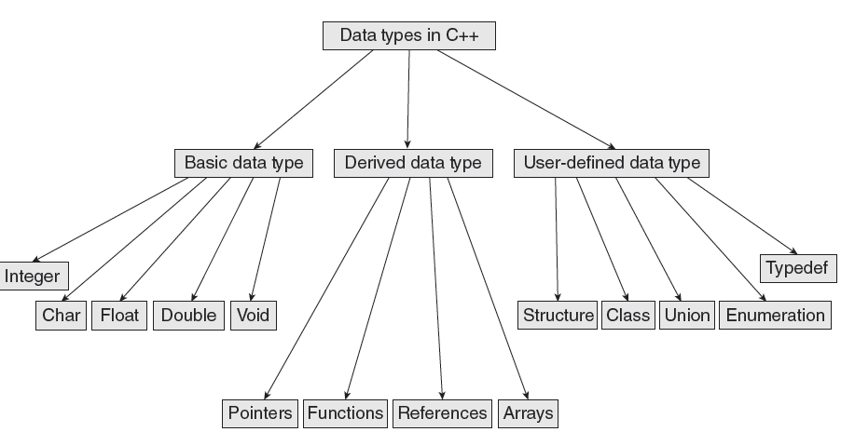
Data Types in C++

Slide 28

Variables
A variable is the content of a memory location that stores a certain value. A variable is identified or denoted by a variable name. The variable name is a sequence of one or more letters, digits or underscore, for example: character_
Rules for defining variable name:
A variable name can have one or more letters or digits or underscore for example character_.
White space, punctuation symbols or other characters are not permitted to denote variable name.
A variable name must begin with a letter.
Variable names cannot be keywords or any reserved words of the C++ programming language.
Data C++ is a case-sensitive language. Variable names written in capital letters differ from variable names with the same name but written in small letters.
01
Local Variables
03
Instance variables
02
Static Variables
04
Final Variables

Slide 29
Variables
Local Variables
Instance Variables
Static Variables
Constant Variables
Local variable: These are the variables which are declared within the method of a class.
Example:
public class Car {
public:
void display(int m){ // Method
int model=m; // Created a local variable model
cout<<model;
}
Instance variable: These are the variables which are declared in a class but outside a method, constructor or any block.
Example:
public class Car {
private: String color;
// Created an instance variable color
Car(String c)
{
color=c;
}}
Static variables: Static variables are also called as class variables. These variables have only one copy that is shared by all the different objects in a class.
Example:
public class Car {
public static int tyres;
// Created a class variable void init(){
tyres=4;
} }
Constant is something that doesn't change. In C language and C++ we use the keyword const to make program elements constant.
Example:
const int i = 10;
void f(const int i)
class Test
{
const int i;
};

Slide 30
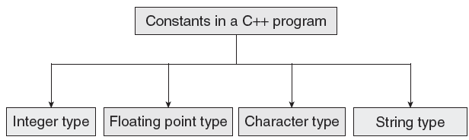
CONSTANTS
Constants are identifiers whose value does not change. While variables can change their value at any time, constants can never change their value.
Constants are used to define fixed values such as Pi or the charge on an electron so that their value does not get changed in the program even by mistake.
A constant is an explicit data value specified by the programmer.
The value of the constant is known to the compiler at the compile time.

Slide 31
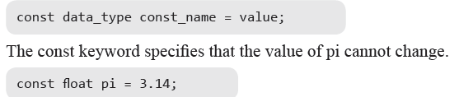

Declaring Constants
Rule 1 Constant names are usually written in capital letters to visually distinguish them from other variable names which are normally written in lower case characters.
Rule 2 No blank spaces are permitted in between the # symbol and define keyword.
Rule 3 Blank space must be used between #define and constant name and between constant name and constant value.
Rule 4 #define is a preprocessor compiler directive and not a statement. Therefore, it does not end with a semi-colon.

Slide 32
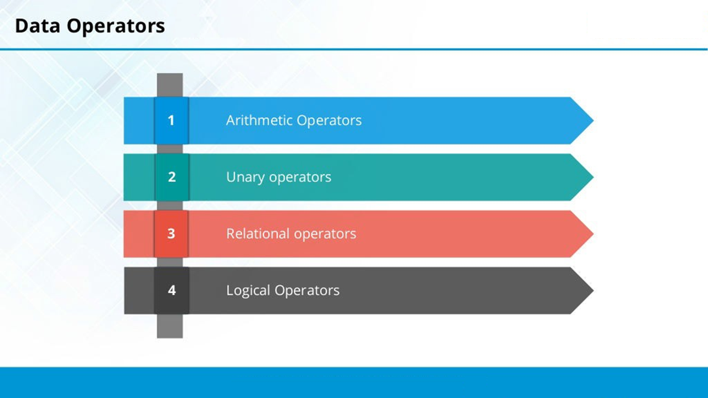

Slide 33
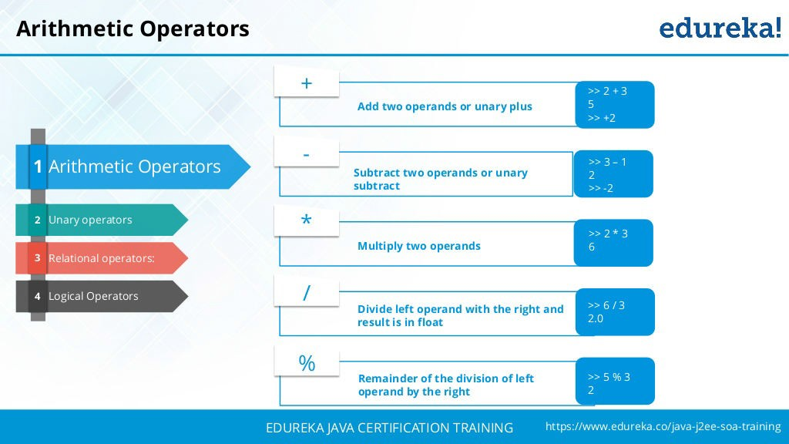

Slide 34
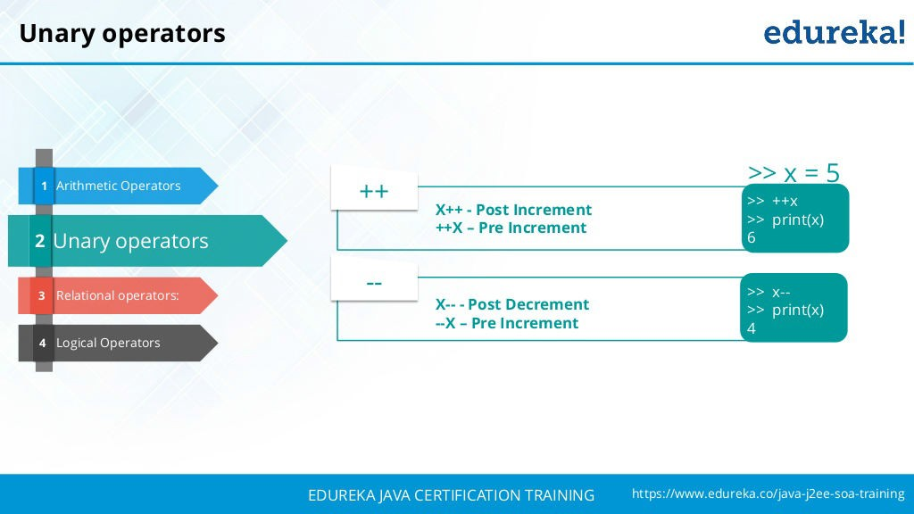

Slide 35
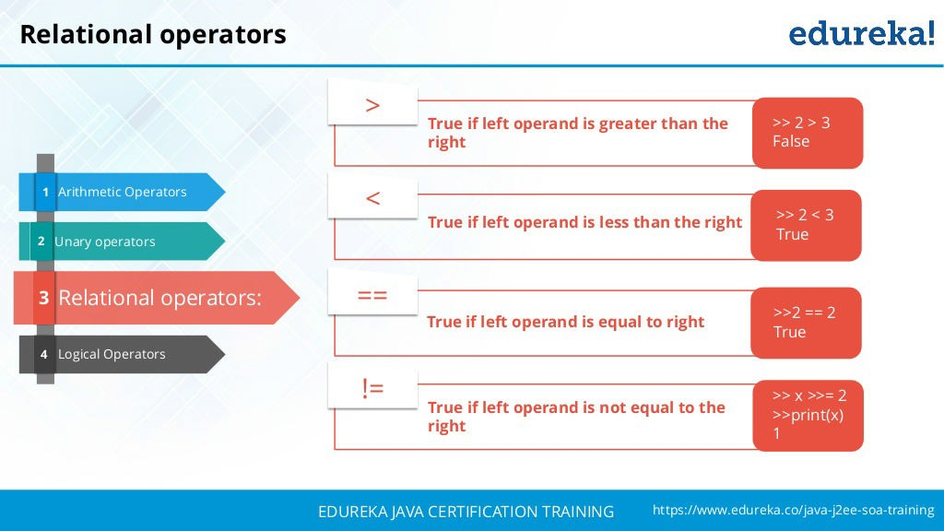

Slide 36
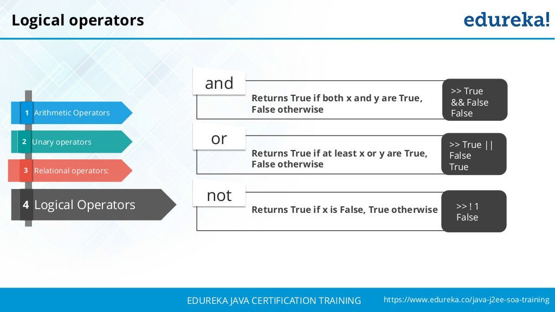

Slide 37

Special Operators
Scope resolution operator
In C, the global version of a variable cannot be accessed from within the inner block. C++ resolves this problem by using scope resolution operator (::), because this operator allows access to the global version of a variable.
1
New Operator
2
The new operator denotes a request for memory allocation on the Heap. If sufficient memory is available, new operator initializes the memory and returns the address of the newly allocated and initialized memory to the pointer variable.
Delete Operator
3
Since it is programmer’s responsibility to deallocate dynamically allocated memory, programmers are provided delete operator by C++ language.
Member Operator
4
C++ permits us to define a class containing various types of data & functions as members. To access a member using a pointer in the object & a pointer to the member.

Slide 38
Operator Precedence
Rank | Operators | Associativity
1 | ++, --, +, -, !(logical complement) ,~(bitwise complement) ,(cast) | Right
2 | *(mul) , /(div), %(mod) | Left
3 | + , - (Binary) | Left
4 | >> , <<, >>> (Shift operator) | Left
5 | >, <, >=,<= | Left
6 | ==, != | Left
7 | & (Bitwise and) | Left
8 | ^ ( XOR) | Left
9 | | (Bitwise OR) | Left
10 | && (Logical and) | Left
11 | || (Logical OR) | Left
12 | Conditional | Right
13 | Shorthand Assignment | Right

Slide 39
Pointers
Pointer is variable in C++
It holds the address of another variable
Syntax data_type *pointer_variable;
Example int *p,sum;
Assignment
integer type pointer can hold the address of another int variable
To assign the address of variable to pointer-ampersand symbol (&)
p=&sum;

Slide 40
How to use it
P=&sum;//assign address of another variable
cout<<&sum; //to print the address of variable
cout<<p;//print the value of variable
Example of pointer
#include<iostream.h>
using namespace std;
int main()
{ int *p,sum=10;
p=&sum;
cout<<“Address of sum:”<<&sum<<endl;
cout<<“Address of sum:”<<p<<endl;
cou<<“Address of p:”<<&p<<endl;
cout<<“Value of sum”<<*p;
}
Output:
Address of sum : 0X77712
Address of sum: 0x77712
Address of p: 0x77717
Value of sum: 10

Slide 41
Pointers and Arrays
assigning the address of array to pointer don’t use ampersand sign(&)
#include <iostream>
using namespace std;
int main(){
//Pointer declaration
int *p;
//Array declaration
int arr[]={1, 2, 3, 4, 5, 6};
//Assignment
p = arr;
for(int i=0; i<6;i++){
cout<<*p<<endl;
//++ moves the pointer to next int position
p++;
}
return 0;
}
OUTPUT:
0
1
2
3
4
5
6

Slide 42
This Pointers
this pointer hold the address of current object
int num;
This->num=num;

Slide 43
This pointer Example
101 Sonoo 890000 102 Nakul 59000
101 Sonoo 890000 102 Nakul 59000
101 Sonoo 890000 102 Nakul 59000
101 Sonoo 890000
#include <iostream>
using namespace std;
class Employee {
public:
int id; //data member (also instance variable)
string name; //data member(also instance variable)
float salary;
Employee(int id, string name, float salary) Output: 101 Sonoo 890000
{
this->id = id; 102 Nakul 59000
this->name = name;
this->salary = salary;
}
void display() {
cout<<id<<" "<<name<<" "<<salary<<endl;
} };
int main(void) {
Employee e1 =Employee(101, "Sonoo", 890000); //creating an object of Employee
Employee e2=Employee(102, "Nakul", 59000); //creating an object of Employee
e1.display(); e2.display(); return 0; }

Slide 44
Function using pointers
#include<iostream>
using namespace std;
void swap(int *a ,int *b );
//Call By Reference
int main()
{
int p,q;
cout<<"\nEnter Two Number You Want To Swap \n";
cin>>p>>q;
swap(&p,&q);
cout<<"\nAfter Swapping Numbers Are Given below\n\n";
cout<<p<<" "<<q<<" \n";
return 0;
}
void swap(int *a,int *b)
{
int c;
c=*a;
*a=*b;
*b=c;
}
Output:
Enter Two Number You Want to Swap
10 20
After Swapping Numbers Are Given below
20 10

Slide 45
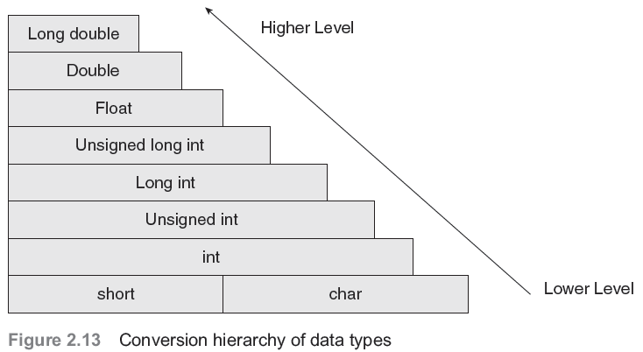
Type conversion and type casting
Type conversion or typecasting of variables refers to changing a variable of one data type into another.
While type conversion is done implicitly, casting has to be done explicitly by the programmer.

Slide 46
Type Casting
Type casting an arithmetic expression tells the compiler to represent the value of the expression in a certain format.
It is done when the value of a higher data type has to be converted into the value of a lower data type.
However, this cast is under the programmer’s control and not under the compiler’s control.
Syntax:
destination_variable_name=destination_data_type(source_variable_name);
float sal=10000.00;
int income;
Income=int(sal);

Slide 47
Session-3
Class and objects

Slide 48
Class:
Class is a user defined data type,
It holds its own data members and member functions,
It can be accessed and used by creating instance of that class.
The variables inside class definition are called as data members and
the functions are called member functions

Slide 49
example:
Class of birds, all birds can fly and they all have wings and beaks. So here flying is a
behavior and wings and beaks are part of their characteristics. And there are many different
birds in this class with different names but they all posses this behavior and characteristics.
class is just a blue print, which declares and defines characteristics and behavior,
namely data members and member functions respectively.
All objects of this class will share these characteristics and behavior.

Slide 50
Class name must start with an uppercase letter(Although this is not mandatory).
Example,
class Student
Classes contain, data members and member functions, and the access of these
data members and variable depends on the access specifiers.
Class's member functions can be defined inside the class definition or outside
the class definition.
class defaults to private access control,
Objects of class holds separate copies of data members. We can create as many
objects of a class as we need.
No storage is assigned when we define a class.

Slide 51
Define a Class Type
Syntax:
Name of the class
Example:
class Class_name
{
permission_label:
member;
permission_label:
member;
...
};
class Rectangle
{
private:
int width;
int length;
public:
void set(int w, int l);
int area();
};
keyword
Body

Slide 52
- Data members Can be of any type, built-in or user-defined.
This may be,
non-static data member
Each class object has its own copy
static data member
Acts as a global variable

Slide 53
Static data member is declared using the static keyword.
There is only one copy of the static data member in the class. All the objects share the static data member.
The static data member is always initialized to zero when the first class object is created.
Syntax:
static data_type datamember_name;
Here
static is the keyword.
data_type – int , float etc…
datamember_name – user defined

Slide 54
Static Data Member
class Rectangle
{
private:
int width;
int length;
static int count;
public:
void set(int w, int l);
int area();
}
Rectangle r1;
Rectangle r2;
Rectangle r3;
count
r1
r2
width
length
width
length
width
length
r3

Slide 55
Member Functions
Used to
access the values of the data members (accessor)
perform operations on the data members (implementor)
Are declared inside the class body
Their definition can be placed inside the class body, or outside the class body
Can access both public and private members of the class
Can be referred to using dot or arrow member access operator

Slide 56
Member function
keyword
Class Name
class Rectangle
{
private:
int width, length;
public:
void set (int w, int l);
int area()
{
return width*length;
}
}r1,;
void Rectangle :: set (int w, int l)
{
width = w;
length = l;
}
int main()
{
Rectangle r2;
r1.set(5,8);
int x=r1.area();
cout<<"x value in r1 "<<x;
r2.set(5,8);
int x=r1.area();
cout<<"x value in r2 "<<x;
}
Object creation
Inside the function
member function
inside the class
class name
Member function
Object
creation
outside the class
scope operator

Slide 57
const member function
The const member functions are the functions which are declared as constant in the program.
The object called by these functions cannot be modified.
It is recommended to use const keyword so that accidental changes to object are avoided.
A const member function can be called by any type of object.
Note: Non-const functions can be called by non-const objects only.
Syntax:
datatype function_name const();
User defined
keyword

Slide 58
Const Member Function
class Time
{
private :
int hrs, mins, secs ;
public :
void Write ( ) const ;
} ;
function declaration
function definition
void Time :: Write( ) const
{
cout <<hrs << “:” << mins << “:” << secs << endl;
}

Slide 59
Access modifiers
The access modifiers are used to set boundaries for availability of members of class be
it data members or member functions
Access modifiers in the program, are followed by a colon.
we can use either one, two or all 3 modifiers in the same class to set different boundaries for
different class members.
C++ has the following types of access modifiers,
1. public
2. private
3. protected

Slide 60
Public:
Public class members declared under public will be available to everyone.
The data members and member functions can be accessed by other classes too.
Hence there are chances that they might change them.
(So the key members must not be declared public).
class Student
{
// public access modifier
public:
int x; // Data Member Declaration
void display(); // Member Function decaration
}

Slide 61
Private :
No one can access the class members which are declared private, outside that class.
When try to access the private members of a class, it will show a compile time error.
The default class variables and member functions are private.
Protected:
it is similar to private, it makes class member inaccessible outside the class.
But they can be accessed by any subclass of that class.
Example:
class A is inherited by class B, then class B is subclass of class A.
so class B can access the class A data members and member functions

Slide 62
What is an object?
OBJECT
set of methods
(member functions)
internal state
(values of private data members)
Operations
Data

Slide 63
Object:
Objects are instances of class, which holds the data variables declared in
class and the member functions work on these class objects.
Each object has different data variables.
Objects are initialized using special class functions called Constructors.
Destructor is special class member function, to release the memory reserved
by the object.
Syntax of creating object :
Class_name object_name;

Slide 64
Declaration of an Object
class Rectangle
{
private:
int width;
int length;
public:
void set(int w, int l);
int area();
};
main()
{
Rectangle r1;
Rectangle r2;
r1.set(5, 8);
cout<<r1.area()<<endl;
r2.set(8,10);
cout<<r2.area()<<endl;
}

Slide 65
Another Example
#include <iostream.h>
class circle
{
private:
double radius;
public:
void store(double);
double area(void);
void display(void);
};
// member function definitions
void circle::store(double r)
{
radius = r;
}
double circle::area(void)
{
return 3.14*radius*radius;
}
void circle::display(void)
{
cout << “r = “ << radius << endl;
}
int main(void) {
circle c; // an object of circle class
c.store(5.0);
cout << "The area of circle c is " << c.area() << endl;
c.display();
}

Slide 66
Declaration of an Object
class Rectangle
{
private:
int width;
int length;
public:
void set(int w, int l);
int area();
};
r1 is statically allocated
main()
{
Rectangle r1;
r1.set(5, 8);
}
r1
width
length
width = 5
length = 8

Slide 67
Declaration of an Object
class Rectangle
{
private:
int width;
int length;
public:
void set(int w, int l);
int area();
};
r2 is a pointer to a Rectangle object
main()
{
Rectangle r1;
r1.set(5, 8);
Rectangle *r2;
r2 = &r1;
r2->set(8,10);
}
//dot notation
//arrow notation
5000
r1
width = 8
length = 10
r2
6000
width
length
width = 5
length = 8
???
5000

Slide 68
Object Initialization
1. By Assignment
#include <iostream.h>
class circle
{
public:
double radius;
};
Only work for public data
members
No control over the operations
on data members
int main()
{
circle c1; // Declare an instance of the class circle
c1.radius = 5; // Initialize by assignment
}

Slide 69
Object Initialization
2. By Public Member Functions
#include <iostream.h>
class circle
{
private:
double radius;
public:
void set (double r)
{radius = r;}
double get_r ()
{return radius;}
};
int main(void) {
circle c; // an object of circle class
c.set(5.0); // initialize an object with a public member function
cout << "The radius of circle c is " << c.get_r() << endl;
// access a private data member with an accessor
}

Slide 70
Session-6 Feature : Objects and Classes

Slide 71
Objects and Classes
Class is a user defined data type, which holds its own data members and member functions, which can be accessed and used by creating instance of that class.
Attributes – member of a class.
An attribute is the data defined in a class that maintains the current state of an object. The state of an object is determined by the current contents of all the attributes.
Methods – member functions of a class

Slide 72
Objects and classes
A class itself does not exist; it is merely a description of an object.
A class can be considered a template for the creation of object
Blueprint of a building 🡪 class
Building 🡪 object
An object exists and is definable.
An object exhibits behavior, maintains state, and has traits. An object can be manipulated.
An object is an instance of a class.

Slide 73
Methods
A method is a function that is part of the class definition. The methods of a class specify how its objects will respond to any particular message.
A method is a collection of statements that perform some specific task and return the result to the caller. A method can perform some specific task without returning anything.
Methods allow us to reuse the code without retyping the code.
A message is a request, sent to an object, that activates a method (i.e., a member function).

Slide 74
Defining a Base Class - Example
A base class is not defined on, nor does it inherit members from, any other class.
#include <iostream>
using std::cout; //this example “uses” only the necessary
using std::endl; // objects, not the entire std namespace
class Fraction {
public:
void assign (int, int); //member functions
double convert();
void invert();
void print();
private:
int num, den; //member data
};
Continued…

Slide 75
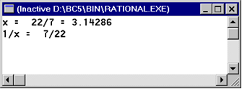
Using objects of a Class - Example
The main() function:
int main()
{
Fraction x;
x.assign (22, 7);
cout << "x = "; x.print();
cout << " = " << x.convert() << endl;
x.invert();
cout << "1/x = "; x.print(); cout << endl;
return 0;
}
Continued…

Slide 76
Defining a Class – Example
Class Implementation:
void Fraction::assign (int numerator, int denominator)
{
num = numerator;
den = denominator;
}
double Fraction::convert ()
{
return double (num)/(den);
}
void Fraction::invert()
{
int temp = num;
num = den;
den = temp;
}
void Fraction::print()
{
cout << num << '/' <
}< den;

Slide 77
Session 7 Topic : UML Class Diagram, its components, Class Diagram relations and Multiplicity

Slide 78
Overview of UML Diagrams
Behavioral
: behavioral features of a system / business process
Activity
State machine
Use case
Interaction
Structural
: element of spec. irrespective of time
Class
Component
Deployment
Object
Composite structure
Package
Interaction
: emphasize object interaction
Communication(collaberation)
Sequence
Interaction overview
Timing

Slide 79
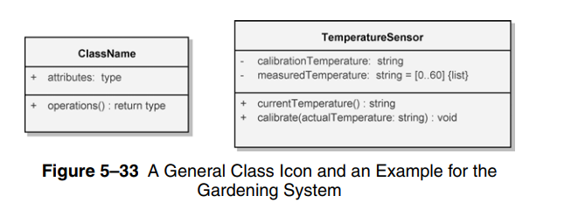
UML Class diagram :
The UML Class diagram is a graphical notation used to construct and visualize object oriented systems.
A class diagram describes the structure of a system such as Classes and their attributes , operations (or methods) and the relationships among objects.
A class diagram is used to show the existence of classes and their relationships in the logical view of a system.

Slide 80
Basic components of a class diagram
The standard class diagram is composed of three sections:
Upper section: Contains the name of the class. This section is always required, to know whether it represents the classifier or an object.
Middle section: Contains the attributes of the class. Use this section to describe the qualities of the class. This is only required when describing a specific instance of a class.
Bottom section: Includes class operations (methods). Displayed in list format, each operation takes up its own line. The operations describe how a class interacts with data.

Slide 81
RULES TO BE FOLLOWED:
Class name must be unique to its enclosing namespace.
The class name begins in uppercase and the space between multiple words is omitted.
The first letter of the attribute and operation names is lowercase with subsequent words starting in uppercase and spaces are omitted.
Since the class is the namespace for its attributes and operations an attribute name must be unambiguous in the context of the class.

Slide 82
Attribute specification format:
visibility attributeName : Type [multiplicity] = DefaultValue {property string}
Operation specification format:
visibility operationName (parameterName : Type) : ReturnType {property string}
VISIBILITY
Public (+) Visible to any element that can see the class.
Protected (#) Visible to other elements within the class and to subclasses .
Private (-) Visible to other elements within the class .
Package (~) Visible to elements within the same package.

Slide 83
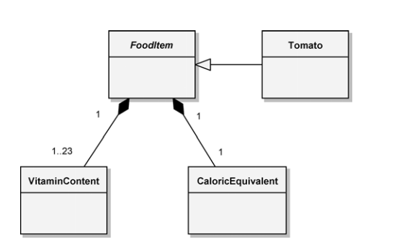
Abstract class
An abstract class is one for which no instances may be created.
Because such classes are so important to engineering good class inheritance trees, there is a special way to designate an abstract class.

Slide 84
To denote that an operation is abstract, we simply italicize the operation name; this means that this operation may be implemented differently by all instances of its subclasses.
In the Hydroponics Gardening System, we have food items that have a specific vitamin content and caloric equivalent, but there is not a type of food called “food item.”
Hence, the FoodItem class is abstract.
Above fig also shows the subclass Tomato, which represents a concrete (instantiable) food item grown in the greenhouse.

Slide 85
Class Relationships
The essential connections among classes include
Association
Generalization
Aggregation
Composition
Association :
The association icon connects two classes and denotes a semantic connection.
Associations are often labeled with noun phrases, such as Analyzes, denoting the nature of the relationship.
A class may have an association to itself (called a reflexive association), such as the collaboration among instances of the PlanAnalyst class.

Slide 86
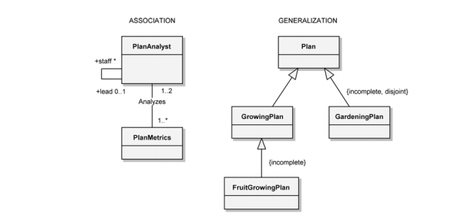

Slide 87
A class may have an association to itself (called a reflexive association), such as the collaboration among instances of the PlanAnalyst class.
The use of both the association end names and the association name is to provide clarity.
It is also possible to have more than one association between the same pair of classes.
Associations may be further adorned with their multiplicity, using the following syntax:
1 Exactly one
* Unlimited number (zero or more)
0..* Zero or more
1..* One or more
0..1 Zero or one
3..7 Specified range (from three through seven, inclusive)

Slide 88
.
GENERALIZATION
The generalization icon denotes a generalization/specialization relationship and appears as an association with a closed arrowhead.
The GrowingPlan class in Figure is the superclass and its subclass is the FruitGrowingPlan
AGGREGATION
Aggregation, as manifested in the “part of ” relationship, is a constrained form of the more general association relationship.

Slide 89
It appears as an association with an unfilled diamond at the end denoting the aggregate (the whole).
The class at the other end denotes the class whose instances are part of the aggregate object.
Reflexive and cyclic aggregation is possible.
In figure, an individual EnvironmentalController class has the Light, Heater, and Cooler classes as its parts.
The multiplicity of * (zero or more) at the aggregate end of the relationship further highlights this lack of physical containment.
COMPOSITION
Composition implies that the construction and destruction of these parts occurs as a consequence of the construction and destruction of the aggregate.

Slide 90
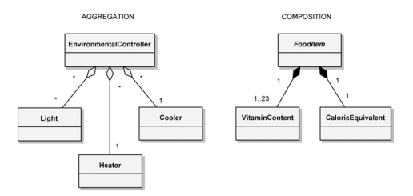
The icons described thus far constitute the essential elements of all class diagrams.
Collectively, they provide the developer with a notation sufficient to describe the fundamentals of a system’s class structure.

Slide 91
Classes
A class is a description of a set of
objects that share the same attributes,
operations, relationships, and semantics.
Graphically, a class is rendered as a
rectangle, usually including its name,
attributes, and operations in separate,
designated compartments.
ClassName
attributes
operations

Slide 92
Class Names
ClassName
The name of the class is the only required tag in the graphical representation of a class. It always appears in the top-most compartment.
attributes
operations

Slide 93
Class Attributes
Person
name : String
address : Address
birthdate : Date
ssn : Id
An attribute is a named property of a
class that describes the object being modeled.
In the class diagram, attributes appear in
the second compartment just below the
name-compartment.

Slide 94
Class Attributes (Cont’d)
Attributes are usually listed in the form:
attributeName : Type
A derived attribute is one that can be
computed from other attributes, but
doesn’t actually exist. For example,
a Person’s age can be computed from
his birth date. A derived attribute is
designated by a preceding ‘/’ as in:
/ age : Date
Person
name : String
address : Address
birthdate : Date
/ age : Date
ssn : Id

Slide 95
Class Attributes (Cont’d)
Person
+ name : String
# address : Address
# birthdate : Date
/ age : Date
- ssn : Id
Attributes can be:
+ public
# protected
- private
/ derived

Slide 96
Class Operations
Person
name : String
address : Address
birthdate : Date
ssn : Id
eat
sleep
work
play
Operations describe the class behavior
and appear in the third compartment.

Slide 97
Class Operations (Cont’d)
PhoneBook
newEntry (n : Name, a : Address, p : PhoneNumber, d : Description)
getPhone ( n : Name, a : Address) : PhoneNumber
You can specify an operation by stating its signature: listing the name, type, and default value of all parameters, and, in the case of functions, a return type.

Slide 98
Depicting Classes
When drawing a class, you needn’t show attributes and operation in every diagram.
Person
Person
Person
name : String
birthdate : Date
ssn : Id
Person
name
address
birthdate
eat()
sleep()
work()
play()
Person
eat
play

Slide 99
Class Responsibilities
A class may also include its responsibilities in a class diagram.
A responsibility is a contract or obligation of a class to perform a particular service.
SmokeAlarm
Responsibilities
-- sound alert and notify guard station
when smoke is detected.
-- indicate battery state

Slide 100
Relationships
In UML, object interconnections (logical or physical), are
modeled as relationships.
There are three kinds of relationships in UML:
dependencies
generalizations
associations

Slide 101
Dependency Relationships
A dependency indicates a semantic relationship between two or
more elements. The dependency from CourseSchedule to Course exists because Course is used in both the add and remove operations of CourseSchedule.
CourseSchedule
Course
add(c : Course)
remove(c : Course)

Slide 102
Generalization Relationships
Person
A generalization connects a subclass
to its superclass. It denotes an
inheritance of attributes and behavior
from the superclass to the subclass and
indicates a specialization in the subclass
of the more general superclass.
Student

Slide 103
Generalization Relationships (Cont’d)
UML permits a class to inherit from multiple superclasses, although some programming languages (e.g., Java) do not permit multiple inheritance.
Student
Employee
TeachingAssistant

Slide 104
Association Relationships
If two classes in a model need to communicate with each other, there must be link between them.
An association denotes that link.
Student
Instructor

Slide 105
Association Relationships (Cont’d)
We can indicate the multiplicity of an association by adding multiplicity adornments to the line denoting the association.
The example indicates that a Student has one or more Instructors:
Student
Instructor
1..*

Slide 106
Association Relationships (Cont’d)
The example indicates that every Instructor has one or more Students:
Student
Instructor
1..*

Slide 107
Association Relationships (Cont’d)
We can also indicate the behavior of an object in an association (i.e., the role of an object) using rolenames.
teaches
learns from
Student
Instructor
1..*
1..*

Slide 108
Association Relationships (Cont’d)
We can also name the association.
membership
Student
Team
1..*
1..*

Slide 109
Association Relationships (Cont’d)
We can specify dual associations.
member of
Student
Team
1..*
1..*
1
president of
1..*

Slide 110
Association Relationships (Cont’d)
We can constrain the association relationship by defining the navigability of the association. Here, a Router object requests services from a DNS object by sending messages to (invoking the operations of) the server. The direction of the association indicates that the server has no knowledge of the Router.
Router
DomainNameServer

Slide 111
Association Relationships (Cont’d)
Associations can also be objects themselves, called link classes or an association classes.
Registration
modelNumber
serialNumber
warrentyCode
Product
Warranty

Slide 112
Association Relationships (Cont’d)
A class can have a self association.
next
LinkedListNode
previous

Slide 113
Association Relationships (Cont’d)
We can model objects that contain other objects by way of special associations called aggregations and compositions.
An aggregation specifies a whole-part relationship between an aggregate (a whole) and a constituent part, where the part can exist independently from the aggregate. Aggregations are denoted by a hollow-diamond adornment on the association.
Car
Engine
Transmission

Slide 114
Association Relationships (Cont’d)
A composition indicates a strong ownership and coincident lifetime of parts by the whole (i.e., they live and die as a whole). Compositions are denoted by a filled-diamond adornment on the association.
Window
Scrollbar
1
1
Titlebar
1
1
Menu
1
1 .. *

Slide 115
Interfaces
An interface is a named set of operations that specifies the behavior of objects without showing their inner structure. It can be rendered in the model by a one- or two-compartment rectangle, with the stereotype <<interface>> above the interface name.
<<interface>>
ControlPanel

Slide 116
Multiplicity
One-to-one
2. One-to-many
3. Many-to-many
One-to-one relationship
For example, in retail telemarketing operations, we would find
a one-to-one relationship between the class Sale and the class
CreditCardTransaction.
Many-to-many relationship
For example, each instance of the class Customer might initiate
a transaction with several instances of the class SalesPerson,

Slide 117
Session 8 Topic : Feature Abstraction and Encapsulation, Application of Abstraction and Encapsulation

Slide 118
Features Of OOPS
DATA ENCAPSULATION
Combining data and functions into a single unit called class and the process is known as Encapsulation.
Provides security, flexibility and easy maintainability
Encapsulation helps us in binding the data(instance variables) and the member functions(that work on the instance variables) of a class.
Encapsulation is also useful in hiding the data(instance variables) of a class from an illegal direct access.
Encapsulation also helps us to make a flexible code which is easy to change and maintain.

Slide 119
Features Of OOPS
ABSTRACTION OR DATA HIDING
Class contains both data and functions. Data is not accessible from the outside world and only those function which are present in the class can access the data.
The insulation of the data from direct access by the program is called data hiding or information hiding. Hiding the complexity of program is called Abstraction and only the essential features are represented.
Uses
1) Makes the application secure by making data private and avoiding the user level error that may corrupt the data.
2) This avoids code duplication and increases the code reusability.

Slide 120
Application of Abstraction
For example, when you send an email to someone you just click send and you get the success message, what actually happens when you click send, how data is transmitted over network to the recipient is hidden from you

Slide 121
ENCAPSULATION
ADVANTAGES
Encapsulated classes reduce complexity.
Help protect our data. A client cannot change an Account's balance if we encapsulate it.
Encapsulated classes are easier to change.

Slide 122
Example
The common example of encapsulation is Capsule. In capsule all medicine are encapsulated in side capsule.
Automatic Cola Vending Machine :Suppose you go to an automatic cola vending machine and request for a cola. The machine processes your request and gives the cola.

Slide 123
Examples
Data Abstraction and Encapsulation
Any C++ program where you implement a class with public and private members is an example of data encapsulation and data abstraction
#include <iostream>
using namespace std;
class Adder {
public:
// constructor
Adder(int i = 0) {
total = i;
}
// interface to outside world
void addNum(int number) {
total += number;
}
// interface to outside world
int getTotal() {
return total;
};
private:
// hidden data from outside world
int total;
};

Slide 124
Session-11
ACCESS SPECIFIERS

Slide 125
Access control in classes
public : A public member is accessible from anywhere outside the class but within a program.
private : A private member variable or function cannot be accessed, or even viewed from outside the class. Only the class and friend functions can access private members.
protected : A protected member variable or function is very similar to a private member but it provided one additional benefit that they can be accessed in child classes which are called derived classes
•

Slide 126






Access Specifiers Example 1
#include <iostream> using namespace std;
class Line
{
public:
double length;
void setLength( double len ); double getLength( void );
};
double Line::getLength(void)
{
return length ;
}
void Line::setLength( double len )
{
length = len;
}
// Main function for the program
int main( )
{
Line line;
// set line length line.setLength(6.0);
cout << "Length of line : " << line.getLength() <<endl;
// set line length without member function
line.length = 10.0; // OK: because length is public cout << "Length of line : " << line.length <<endl; return 0;
}
Length of line : 6 Length of line : 10

Slide 127






Access Specifiers Example 2
#include <iostream>
using namespace std; class Box
{
public:
double length;
void setWidth( double wid ); double getWidth( void );
private:
double width;
};
// Member functions definitions double Box::getWidth(void)
{
return width ;
}
void Box::setWidth( double wid )
{
width = wid;
}
// Main function for the program int main( )
{
Box box;
// set box length without member function box.length = 10.0; // OK: because length is public cout << "Length of box : " << box.length <<endl;
// set box width without member function
// box.width = 10.0; // Error: because width is private box.setWidth(10.0); // Use member function to set it. cout << "Width of box : " << box.getWidth() <<endl;
return 0;
}
Length of box : 10 Width of box : 10

Slide 128




Access Specifiers Example 3
#include <iostream> using namespace std;
class Box
{
protected: double width;
};
class SmallBox:Box
{
public:
void setSmallWidth( double wid ); double getSmallWidth( void );
};
// Member functions of child class double SmallBox::getSmallWidth(void)
{
return width ;
}
void SmallBox::setSmallWidth( double wid )
{
width = wid;
}
// Main function for the program int main( )
{
SmallBox box;
// set box width using member function box.setSmallWidth(5.0);
cout << "Width of box : "<< box.getSmallWidth();
return 0;
}
Width of box : 5

Slide 129
Friend function
A friend function of a class is defined outside that class' scope but it has the right to access all private and protected members of the class.
Even though the prototypes for friend functions appear in the class definition, friends are not member functions.
A friend can be a function, function template, or member function, or a class or class template, in which case the entire class and all of its members are friends.

Slide 130
Friend function Example
#include <iostream>
using namespace std;
class XYZ
{
private: int num=100;
char ch='Z';
public: friend void disp(XYZ obj);
};
//Global Function
void disp(XYZ obj)
{
cout<<obj.num<<endl;
cout<<obj.ch<<endl;
}
int main()
{
XYZ obj;
disp(obj);
return 0;
}

Slide 131
Inline Function
C++ provides an inline functions to reduce the function call overhead.
Inline function is a function that is expanded in line when it is called.
When the inline function is called whole code of the inline function gets inserted or substituted at the point of inline function call. This substitution is performed by the C++ compiler at compile time.
Inline function may increase efficiency if it is small.

Slide 132
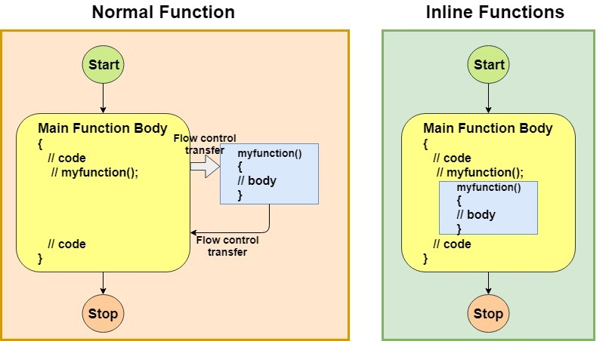
Inline Function - Example

Slide 133
Inline Function - Example
include <iostream>
using namespace std;
inline int Max(int x, int y) {
return (x > y)? x : y;
}
// Main function for the program
int main() {
cout << "Max (20,10): " << Max(20,10) << endl;
cout << "Max (0,200): " << Max(0,200) << endl;
cout << "Max (100,1010): " << Max(100,1010) << endl;
return 0;
}
Output:
Max (20,10): 20
Max (0,200): 200
Max (100,1010): 1010

Slide 134
Session 12
Topic : UML use case Diagram, use case, Scenario, Use case Diagram objects and relations

Slide 135
USECASE DIAGRAM
Use case diagrams give us that capability.
Use case diagrams are used to depict the context of the system to be built and the functionality provided by that system.
They depict who (or what) interacts with the system. They show what the outside world wants the system to do.

Slide 136
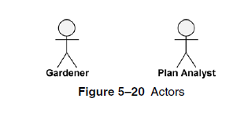
NOTATIONS
Actors are entities that interface with the system.
They can be people or other systems.
Actors, which are external to the system they are using, are depicted as stylized stick figures.

Slide 137
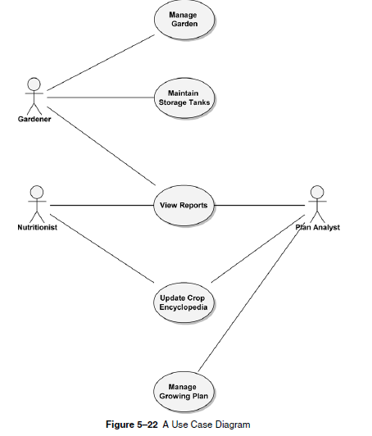

Slide 138
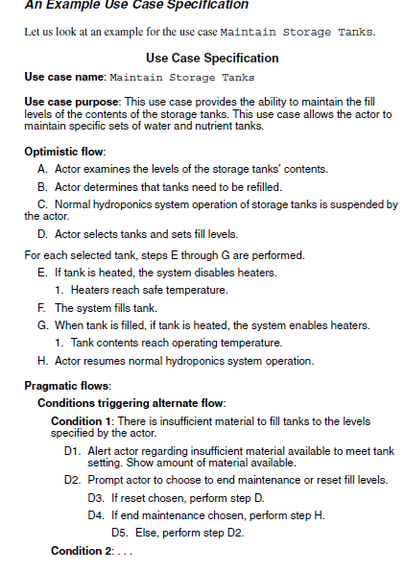

Slide 139
Relationship
Two relationships used primarily for organizing use case models are both powerful
«include» relationship
«extend» relationship

Slide 140
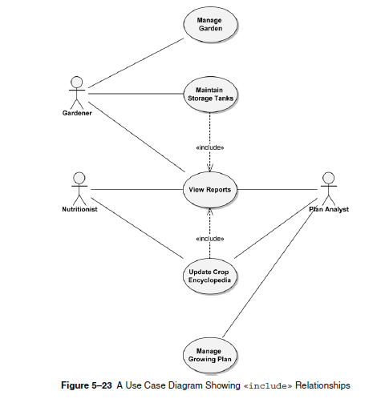

Slide 141
«include» relationship
In our hydroponics example, we have an Update Crop Encyclopedia use case.
During analysis, we determine that the Nutritionist actor using that use case will have to see what is in the crop encyclopedia prior to updating it.
This is why the Nutritionist can invoke the View Reports use case.
The same is true for the Gardener actor whenever invoking Maintain StorageTanks.

Slide 142
Neither actor should be executing the use cases blindly. Therefore, the View Report use case is a common functionality that both other use cases need.
This can be depicted on the use case model via an «include» relationship, as shown in Figure.
This diagram states, for example, that the Update Crop Encyclopedia usecase includes the View Reports use case.
This means that View Reports must be executed when Update Crop Encyclopedia is executed.
UpdateCrop Encyclopedia would not be considered complete without View Reports.

Slide 143
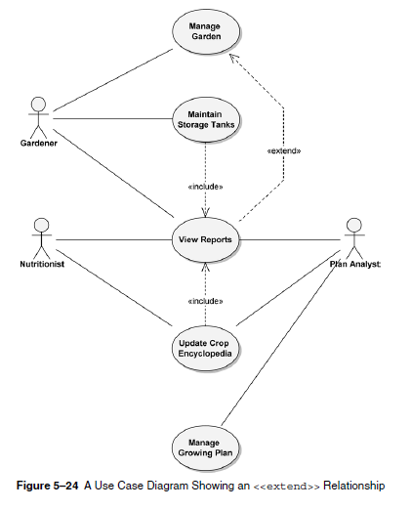
«extend» Relationships

Slide 144
While developing your use cases, you may find that certain activities might be performed as part of the use case but are not mandatory for that use case to run successfully.
In our example, as the Gardener actor executes the Manage Garden use case, he or she may want to look at some reports.
This could be done by using the View Reports use case.
However, View Reports is not required when Manage Garden is run. Manage Garden is complete in and of itself. So, we modify the use case diagram to indicate that the View Reports use case extends the Manage Garden use case.

Slide 145
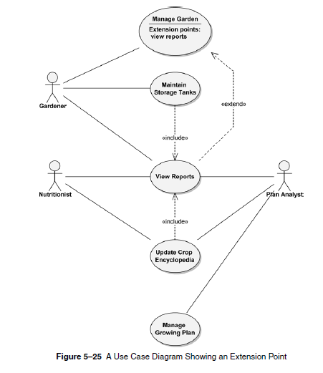
Where an extending use case is executed, it is indicated in the use case specification as an extension point.
The extension point specifies where, in the flow of the including use case, the extending use case is to be executed.

Slide 146
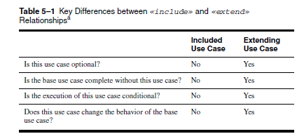

Slide 147
Session 13 Topic : Constructor and Destructor

Slide 148
Object Initialization
By Constructor
Default constructor
Copy constructor
Constructor with parameters

Slide 149
Constructor
It is a special kind of class member function that is automatically called when
an object of that class is instantiated.
Constructors are typically used to initialize member variables of the class to appropriate default or user-provided values.
constructors have specific rules for how they must be named:
Constructors must have the same name as the class (with the same capitalization) .Constructors have no return type (not even void)

Slide 150
Example for default constructor:
#include <iostream>
using namespace std;
class Employee
{
public:
Employee()
{
cout<<"Default Constructor Invoked"<<endl;
}
};
int main(void)
{
Employee e1; //creating an object of Employee
Employee e2;
return 0;
}

Slide 151
Constructor with parameter:
A constructor which has parameters is called parameterized constructor.
It is used to provide different values to distinct objects.

Slide 152
Example for constructor with parameter
Creating an object of Employee
#include <iostream>
using namespace std;
class Employee {
public:
int id;//data member (also instance variable)
string name;//data member(also instance variable)
float salary;
Employee(int i, string n, float s)
{
id = i;
name = n;
salary = s;
}
void display()
{
cout<<id<<" "<<name<<" "<<salary<<endl;
}
};
int main(void) {
Employee e1 =Employee(101, "Sonoo", 890000); e2=Employee(102, "Nakul", 59000);
e1.display();
e2.display();
return 0;
}

Slide 153
Copy constructor:
Copy Constructor is a type of constructor which is used to create a copy of an
already existing object of a class type.
The compiler provides a default Copy Constructor to all the classes.
Copy Constructor is called in the following scenarios:
When we initialize the object with another existing object of the same class type.
For example, Student s1 = s2, where Student is the class.
When the object of the same class type is passed by value as an argument.
When the function returns the object of the same class type by value.

Slide 154
Example for copy constructor
#include <iostream>
using namespace std;
class A
{
public:
int x;
A(int a) // parameterized constructor.
{
x=a;
}
A(A &i) // copy constructor
{
x = i.x;
}
};
int main()
{
A a1(20); // Calling the parameterized constructor.
A a2(a1); // Calling the copy constructor.
cout<<a2.x;
return 0;
}

Slide 155
Destructor:
Destructors have the same name as their class and their name is preceded by a tilde(~).
Destructors in C++ are members functions in a class that delete an object.
They are called when the class object goes out of scope such as when the function ends, the program ends, a delete variable is called etc.
Destructors are don’t take any argument and don’t return anything.

Slide 156
When does the destructor get called?
A destructor is automatically called when: 1) The program finished execution. 2) When a scope (the { } parenthesis) containing local variable ends. 3) When you call the delete operator.

Slide 157
Example program for destructor
#include <iostream>
using namespace std;
class HelloWorld{
public:
HelloWorld(){
cout<<"Constructor is called"<<endl;
}
~HelloWorld(){
cout<<"Destructor is called"<<endl;
}
//Member function
void display(){
cout<<"Hello World!"<<endl;
}
};
int main()
{
HelloWorld obj; //Object created
obj.display();
return 0;
}
Constructor
//Member function called
Destructor
output
Constructor is called
Hello World!
Destructor is called

Slide 158
Destructor rules
1) Name should begin with tilde sign(~) and must match class name. 2) There cannot be more than one destructor in a class. 3) Unlike constructors that can have parameters, destructors do not allow any parameter. 4) They do not have any return type, just like constructors. 5) When you do not specify any destructor in a class, compiler generates a default destructor and inserts it into your code.

Slide 159
Constructor
A constructor is a member function that is invoked automatically when an object is declared.
It has the same name as the class and carries no return type (not even void).
The Compiler calls the Constructor whenever an object is created
Syntax:
class A
{
public:
A() // constructor
{ }
};

Slide 160
Constructor
Constructor can be defined either inside the class or outside of the class using scope resolution operator ::
Example
class A
{
int a;
public:
A(); // constructor declaration
};
A::A() // constructor definition
{
a = 10;
}

Slide 161
Methods
A method is a function that is part of the class definition. The methods of a class specify how its objects will respond to any particular message.
A method is a collection of statements that perform some specific task and return the result to the caller. A method can perform some specific task without returning anything.
Methods allow us to reuse the code without retyping the code.
A message is a request, sent to an object, that activates a method (i.e., a member function).

Slide 162
Method Vs Constructor
Used to define particular task for execution
Method can have same name as class name or different name based on the requirement
Explicit call statement required to call a method
There is no default method provided by compiler
Return data type must be declared
Used to initialize the data members
Constructor has same name as the class name
Constructor is automatically called when an object is created
There is always default constructor provide by compiler
Return type is not required in constructor

Slide 163
Types of Constructor
Types of Constructors in C++
Constructors are of three types:
Default Constructor - Default constructor is the constructor which doesn't take any argument. It has no parameter.
Parametrized Constructor : These are the constructors with parameter. Using this Constructor you can provide different values to data members of different objects, by passing the appropriate values as argument.
Copy Constructor: These are special type of Constructors which takes an object as argument, and is used to copy values of data members of one object into other object.

Slide 164
Example Program
// copy constructor
Student (const Student &s)
{
rollno = s.rollno;
name = s.name;
}
}; // end of class
int main()
{
Student A1();
Student A(10);
Student B=A;
}
class Student
{
public:
int rollno;
string name;
Student() //Default constructor
{ rollno = 0;
name = "None";
}
Student(int x) // parameterized
{ rollno = x;
name = "None";
}

Slide 165
Destructor
A destructor is a special member function of a class that is executed whenever an object of it's class goes out of scope or whenever the delete expression is applied to a pointer to the object of that class.
Example
class Line
{
public:
st1………
st2……….
Line();
~Line(); // This is the destructor: declaration
};

Slide 166


